Slide 1
Lesson objective
PBiS focus
Respect – listening
Learn – seek help when needed
Title: Time revision
Aim – be able to:
Use written strategies to determine periods of time
Plan:
Review Venn diagrams
Time strategies
Notes page

Slide 2
Venn diagram
40
U = ________
20 people had blue eyes
27 people had brown hair
12 had both
5 had neither
Blue eyes
Brown hair
Both
8
15
12
5
Notes:
Probability of blue eyes are brown hair
Probability of blue eyes or brown hair
Probability of not having brown hair

Slide 3
Venn diagram
60
U = ________
P (fishing and crabbing)
P (Fishing or crabbing)
P (Not fishing)
Fishing
Crabbing
Both
12
15
19
14
Notes:
Probability of blue eyes are brown hair
Probability of blue eyes or brown hair
Probability of not having brown hair

Slide 4
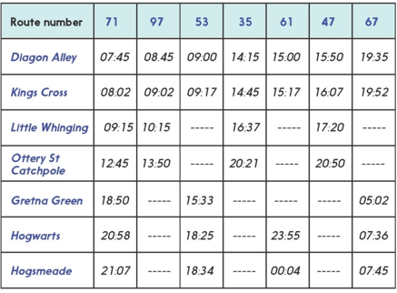
How long does it take for Route 71 to get from Diagon Alley to Hogsmeade?
How long does it take Route 61?
How much faster is Route 61?

Slide 5
Time questions
Jack works for 7 and a half hours. If he starts at 6:25am, what time does he finish?
Jane catches a train at 0840 and arrives at her station at 1530. How long was the train trip?
The Simpsons movie runs for 87 minutes. If we start watching it at 2:40pm, when will it finish?

Slide 6
Exercise book
What time is it 2 and a half hours after 4:45pm?
Mr. Davies gets to school at 7:45am, he leaves at 5:25pm. How long was he at school?
How much time has passed between 0950 and 1435?

Slide 7
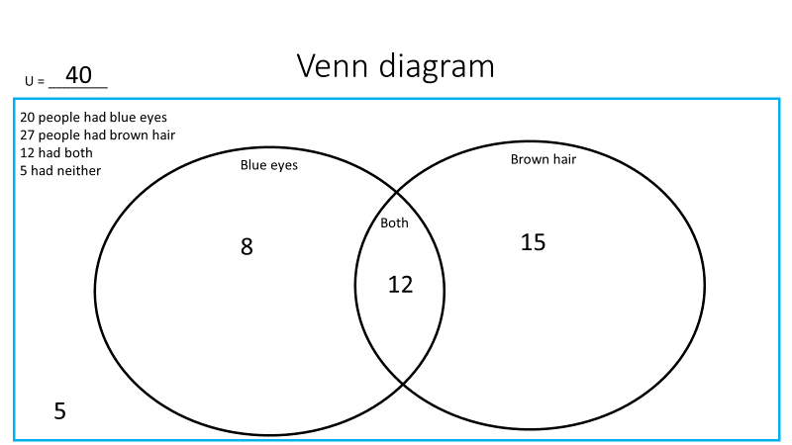
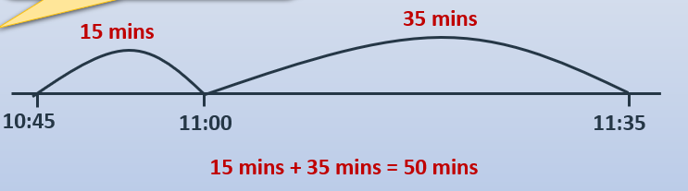





Notes
Ratio
Title ➔ boy : girls
Ratio ➔ 12 : 18
Simplified ➔ 2 : 3
P (blue eyes or brown hair) = 35/40
P (blue eyes and brown hair) = 12/40
P (not blue eyes) = 20/40

Slide 8

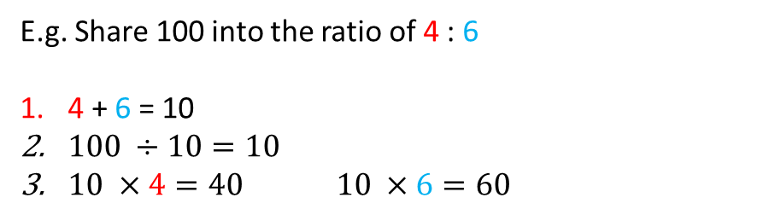

Notes continued
SHARING with ratio
Add together the total number of parts of the ratio
Divide the given amount by the total number of parts
Multiply the answer by each ratio amount
Check that your answers add up to the same total given in the question
Simplifying ratios (NO DECIMALS)
e.g. 7 : 21
So 1 : 3
THINK: what number goes into both numbers?
$$÷7$$
$$÷7$$
E.g. Share 100 into the ratio of 4 : 6
4 + 6 = 10
$100 ÷10=10$
$10 ×4=40 10 ×6=60$

